Slide 1
Annual Title I
Parent Meeting
2023-2024
Howard Middle School
Anthony "Tony" Jones
Aug. 30, 2023 Time: 10:00AM and 4:00PM
Notes:
Note: Please do not remove any of the information from this presentation. The contents consist of items directly aligned with the Title I Law. Please ADD items as needed, i.e. your school’s data charts, grade level requirements, parent and family engagement documents/activities etc. Thank you.

Slide 2
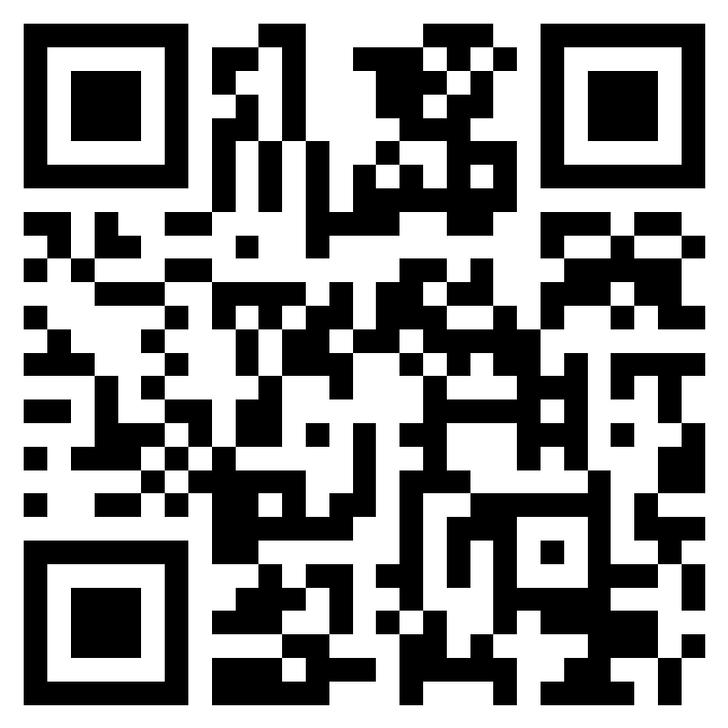
Please Sign-In…
https://forms.office.com/r/yEVEcbM8RT
Note: Link can be found in the Chat box
Notes:
To document your attendance today, scan the QR Code or click the link found in the chat box. If you have more than one child, you will only need to enter the lunch number for one of your children. Thank you for signing in! This helps us keep a record of all parents and family members who attend our trainings.

Slide 3
OUR VISION
Students are empowered to learn, lead, innovate and serve as productive and caring citizens within their chosen paths of success.
OUR MISSION
The Bibb County School District maximizes student achievement and social-emotional well-being by building a sense of community in safe, equitable learning environments.

Slide 4
OUR GUIDING PRINCIPLES
OUR GOALS
LEARNER OUTCOMES
Student Achievement
Staff Effectiveness
Stakeholder Engagement
Each student
will graduate empowered to make a well-informed decision about their next step. They will learn about themselves as they engage in rigorous content and gain exposure through personalized learning experiences, thereby enlightening them to choose their most meaningful pathway.
Personalized Learning
Collaboration
Engagement
Safety
Effective Leadership
Notes:
Our goals are… Our guiding principles are… the 4ME Learner Outcomes are…

Slide 6
Our Agenda…
What is a Title I School?
How does our school participate in the Title I Program?
What are the benefits of Title I funding?
How does our school spend Title I money?
What are our school’s Title I schoolwide requirements?
What are the district and school goals?
What curriculum does our school use?
What is the College and Career Ready Performance Index (CCRPI)?
What tests will my child take?

Slide 7
Our Agenda…
What is Family Engagement?
What is required by law for parent and family engagement?
Does my child’s teacher meet professional qualifications?
How are parents of English Learners (Els) who are eligible to participate in the District’s Title III or Title I supplemental language program notified?
What opportunities does the school provide for family engagement?
How responsive will the school be to questions when staff is contacted?
Closing and evaluations

Slide 8
What is a Title I School?
The purpose of Title I under the Elementary and Secondary
Education Act of 1965 (ESEA) is to ensure that all children
have a fair, equal, and significant opportunity to obtain a
high-quality education and each, at a minimum, proficiency
on challenging state academic achievement standards and
state academic assessments.
In 2015, The Every Student Succeeds Act (ESSA) replaced
its predecessor, the No Child Left Behind Act (NCLB), and modified but did not eliminate
provisions relating to the periodic standardized tests given to students. Like the NCLB
Act, ESSA is a reauthorization of the 1965 Elementary and Secondary Education Act,
which established the federal government’s expanded role in public education.
A Title I school has qualified to receive federal funding under this act.

Slide 9
How does our school participate in the Title I Program?
Hiring additional teachers and other support staff to reduce class size.
Purchasing supplemental instructional materials and educational programs.
Conducting parent activities and workshops focusing on content academic area.
Providing professional development for teachers and staff.

Slide 10
What are the benefits of Title I Funding?
All Bibb County Public Schools are Title I schoolwide programs.
In a schoolwide school, all students benefit from Title I resources.
Parents and family members have substantial and meaningful opportunities to participate in the education of their children.

Slide 11
How does our school spend Title I money?
Educational Resources for children
Personnel
Academic Coaches
Family Engagement
Supplies for parent resource center/area
Family Engagement Facilitators

Slide 12
What are our school’s Title I schoolwide requirements?
All teachers must meet State and/or local professional qualifications and licensing criteria for the grade levels and subject areas they teach.
Parents have the right to know the qualifications of the teachers.
Proven, evidence-based instructional methods must be utilized in the classroom.

Slide 13
District Goals
Strategic Goal 1: Student Achievement
All students will continually demonstrate high academic and social-emotional growth preparing them for life, college, and careers.
Strategic Goal 2: Staff Effectiveness
All employees will excel daily in the performance of their roles to ensure our district thrives.
Strategic Goal 3: Stakeholder Engagement
We will build collective ownership and active engagement among all stakeholders to maximize students’ overall learning experience.

Slide 14
School Goals
Reading
By the end of 2024, increase the percentage of students reaching their reading goal on or above grade level by 50%, as measured by the Georgia Milestones.
Math
By the end of 2024, increase the percentage of students’ proficiency in math on or above grade level by 50% as measured by the Georgia Milestones.

Slide 15
What curriculum does our school use?
English Language Development Standards (English Language Learners)
I-Ready
Star Reading
Freckle
Accelerated Reading
Notes:
Please do not delete English Language Learners information. This is a requirement.

Slide 16
What is the College and Career Ready Performance Index?
The CCRPI is the state accountability method used to measure school performance. The following indicators will be used to determine performance instead of a single test score:
Content Mastery
Progress
Closing Gaps
Readiness
Graduation Rate (high schools only)

Slide 17
Georgia School State Report Card
For school years 2019-2020, 2020-2021, and 2021-2022, various pandemic related issues resulted in incomplete data for most metrics and there was significant variation in student participation rates where data are available.
Additionally, the GaDOE did not calculate a CCRPI for school years 2019-2020, 2020-2021, and 2021-2022. Since Georgia’s Office of Student Achievement’s, A-F grade is based on the school’s CCRPI calculation, there is not a state a letter grade for the affected years. It is not advisable to make comparisons between schools and/or districts for these years.
GaDOE is in the process of submitting to the U.S. Department of Education an updated ESEA Consolidated Plan and additional changes to the CCRPI, the state’s accountability system. More information will be available once an updated plan is approved.
For more detailed information:
Link to BCSD State Report Card
https://public.gosa.ga.gov/noauth/extensions/SchoolGrades-
Georgia/SchoolGrades-Georgia.html?SchoolName=bibb-county
Notes:
Important Note: Use the 2018-2019 CCRPI Score for the district and your school.
Say: The GaDOE was unable to calculate a CCRPI for school years 2019-2020 and 2020-2021.
The fiscal year 2022 testing data will be used to establish a new baseline for future years.
To date, we are still awaiting guidance from the GaDOE concerning CCRPI scores.

Slide 18
What test will my child take
WIDA Assessments (English Language Learners)
Georgia Milestones End of Grade (EOG) Grades 6-8 -Georgia Milestones reports student achievement in four levels: Beginning Learners: Proficiency in the course is not demonstrated. Substantial academic support needed. Developing Learners: Partial proficiency in the course is demonstrated. Additional academic support needed. Proficient Learners: Proficiency in the course is demonstrated.
Formative and Summative Assessment
Progress Assessments/Benchmarks
Notes:
Please do not delete English Language Learners (WIDA) information. This is a requirement.

Slide 19
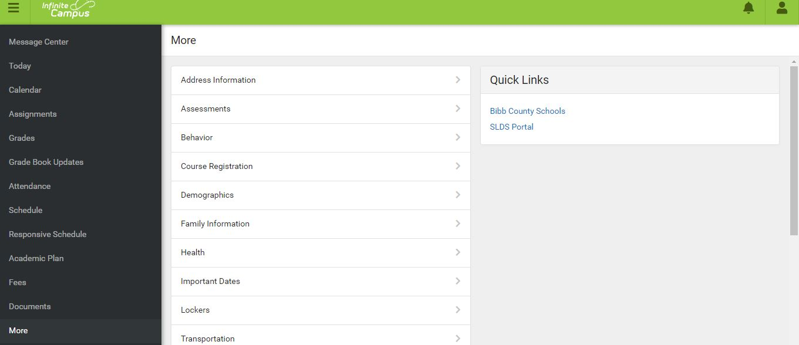
Parent Portal SLDS
Notes:
Infinite Campus Parent Portal is an online/mobile application where parents can obtain access to their child’s/children’s previous test performance, standards information, and attendance using the Statewide Longitudinal Data System (SLDS) or SLDS portal link.
Through the school’s parent portal, parents can also receive updates on their child's progress and assignments, access their child’s/children’s end of the year report cards, as well as to instantly provide change of address, contact information, and much more! Every parent has a Campus Parent Login, so please sign up today for your Parent Portal if you do not already have one and stay tune for Parent Portal training coming soon.

Slide 20
What is Family Engagement?
Family Engagement means the participation of parents and family members in regular, two-way, and meaningful communication involving student academic learning and other school activities.
Parents play an integral role in assisting their child’s learning.
Parents are encouraged to be actively involved in their child’s education.
Parents are full partners in their child’s education and are included, as appropriate, in decision-making and on advisory committees to assist in the education of their child.
Parents assist with carrying out other activities, such as those described in Section 1116 of the Every Student Succeeds Act (ESSA).

Slide 21
Title I 2023-2024 Guidebook
Title I 2023-2024
Parent and Family
Engagement Guidebook
The Title I Parent and Family
Engagement Guidebook also
Provides parents with
Information on family
Engagement and ESSA mandates.

Slide 22
Title I Family Engagement Requirements
District Level Title I Parent and Family Engagement Plan
School Level Title I Parent and Family Engagement Plan
School-Parent Compact
Family Engagement Events
Building Capacity
Accessibility
Notes:
Both the District and schools are required to develop a Parent and Family Engagement Plan that include a section on school-parent compacts, building parent and staff capacity, family engagement events and accessibility information.
District Level Title I Parent and Family Engagement Plan
In support of strengthening student academic achievement, the Bibb County School District (BCSD) jointly developed a parent and family engagement plan that establishes the district’s expectations and objectives for meaningful family engagement. It describes BCSD’s commitment to engage families in the education of their children and builds the capacity of its Title I schools to succeed in reaching the district and student academic achievement goals.
School Level Title I Parent and Family Engagement Plan
This is a plan that describes how Insert school’s name will provide opportunities to improve family engagement to support student learning. Insert school’s name values the contributions and involvement of parents and family members to establish an equal partnership for the common goal of improving student achievement. This plan describes the different ways that Insert school’s name will support family engagement and how parents can help plan and participate in activities and events to promote student learning at school and at home.
School-Parent Compact
A School-Parent Compact is a written agreement between parents, students and teachers developed together. It explains what families and schools can do to help children reach grade-level standards.
An Effective Compact links to Learning:
Links goals to the school improvement plan.
Focuses on students learning skills.
Describes how teachers will help students develop those skills using high-quality instruction.
Shares strategies parents can use at home.
Explains how teachers and parents will communicate about student progress.
Describes opportunities for parents to volunteer, observe, and participate in the classroom.
Building Capacity
Build capacity to involve parents/stakeholders in an effective partnership with the school.
Share and support high student academic achievement.
Family Engagement Events
Insert school’s name will host the family engagement events to build the capacity for strong family engagement to support a partnership among the school, parents, and the community to improve student academic achievement. All meetings for parents and family members will be held insert school information here. (Example: twice during the day in the morning before school and in the evening at 7:00 pm)
Accessibility
Provide full opportunities of parents with limited English proficiency, parents of migratory children, and parents with disabilities.
Provide information and school reports in a language parents can understand, such as translated flyers or an interpreter present at meetings.

Slide 23
2023-2024 District Plan
2023-2024 District Parent and
Family Engagement Plan
The plan describes how the District will:
Involve parents in the CLIP and LEA Plan.
Provide coordination and technical assistance to schools for family engagement.
Build parent and school capacity.
Evaluate the plan annually.
Involve parents in Title I school activities.
Notes:
District Level Title I Parent and Family Engagement Plan
In support of strengthening student academic achievement, the Bibb County School District (BCSD) jointly developed a parent and family engagement plan that establishes the district’s expectations and objectives for meaningful family engagement. It describes BCSD’s commitment to engage families in the education of their children and builds the capacity of its Title I schools to succeed in reaching the district and student academic achievement goals.

Slide 24
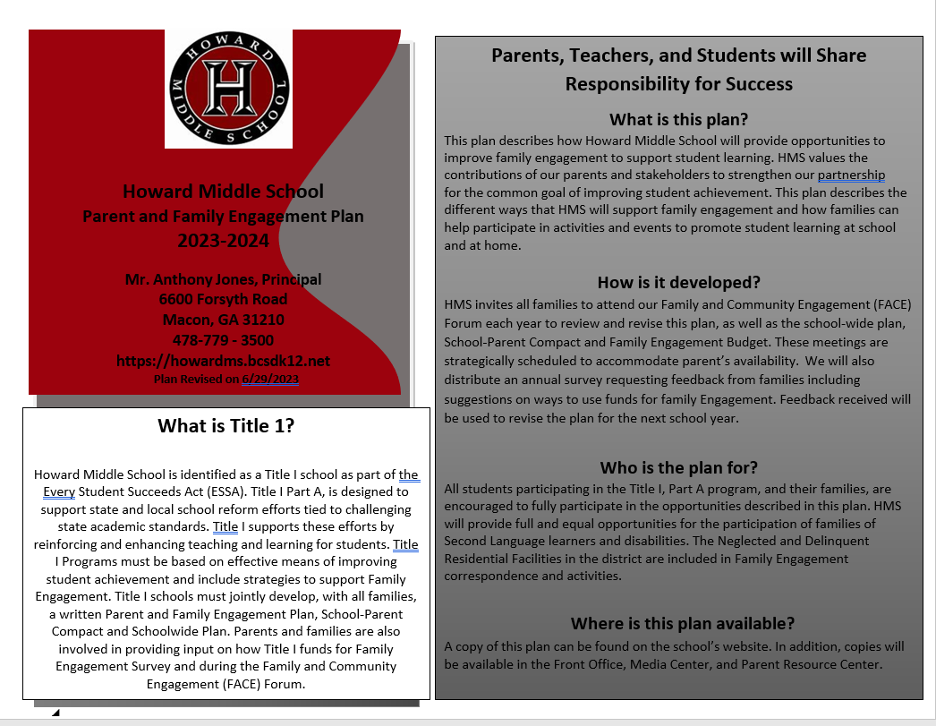
2023-2024 School Parent and Family Engagement Plan
Each school that receives Title I funds
must jointly develop and distribute to
parents and family members of children
receiving services a written parent and
family engagement plan.
Our plan describes how we will carry
out the parent and family engagement
requirements to ensure effective
engagement of parents and to support
a partnership among the school,
parents, and the community to improve
student academic achievement.
Notes:
School Level Title I Parent and Family Engagement Plan
This is a plan that describes how Insert school’s name will provide opportunities to improve family engagement to support student learning. Insert school’s name values the contributions and involvement of parents and family members to establish an equal partnership for the common goal of improving student achievement. This plan describes the different ways that Insert school’s name will support family engagement and how parents can help plan and participate in activities and events to promote student learning at school and at home.

Slide 25
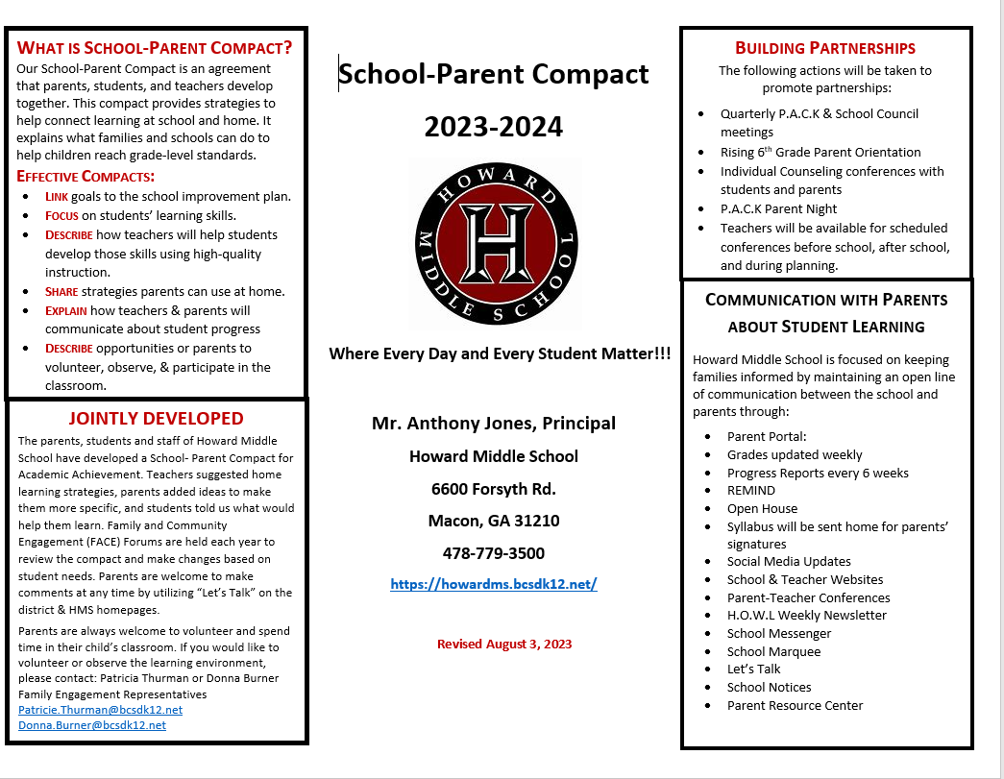
2023-2024 School-Parent Compact
Each school that receives Title I funds
must jointly develop and revise with
parents and students a school-parent
compact as part of our parent and
family engagement plan.
Our school-parent compact is an agreement that outlines how parents,
the entire school staff, and students
will share the responsibility for
improved student academic
achievement.
Notes:
School-Parent Compact
A School-Parent Compact is a written agreement between parents, students and teachers developed together. It explains what families and schools can do to help children reach grade-level standards.
An Effective Compact links to Learning:
Links goals to the school improvement plan.
Focuses on students learning skills.
Describes how teachers will help students develop those skills using high-quality instruction.
Shares strategies parents can use at home.
Explains how teachers and parents will communicate about student progress.
Describes opportunities for parents to volunteer, observe, and participate in the classroom.

Slide 26
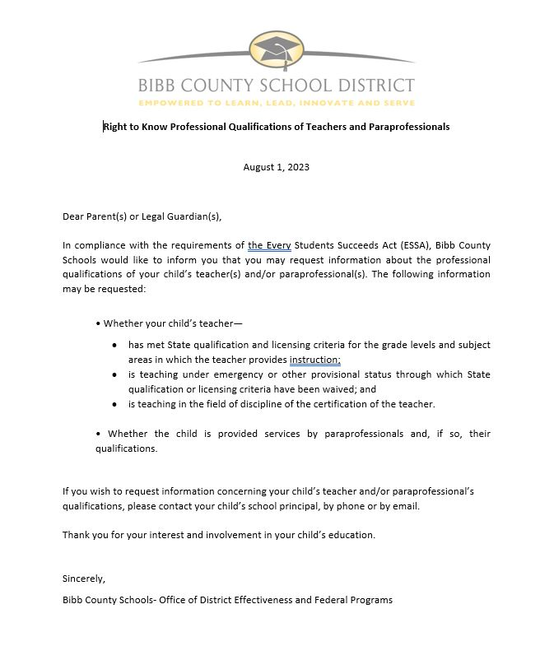
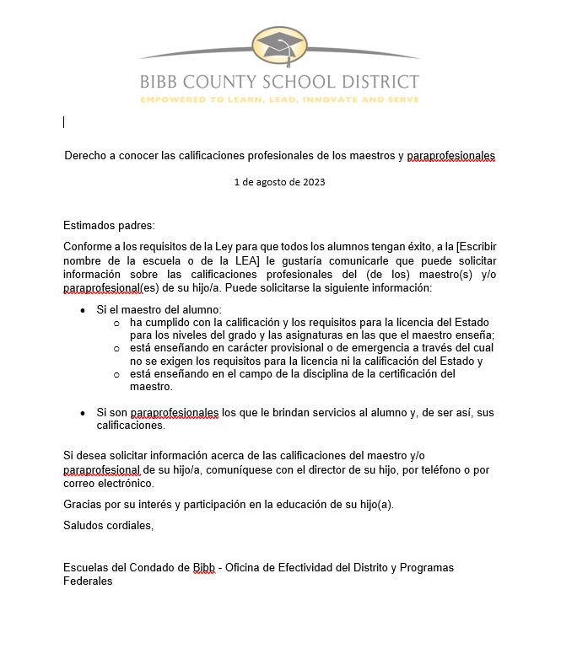
Right to Know Letter
Right to Know Professional
Qualifications of Teachers and
Paraprofessionals
Parents have the right to request
information concerning the
qualifications of their child’s
teachers and/or paraprofessionals
by contacting the school principal.

Slide 27
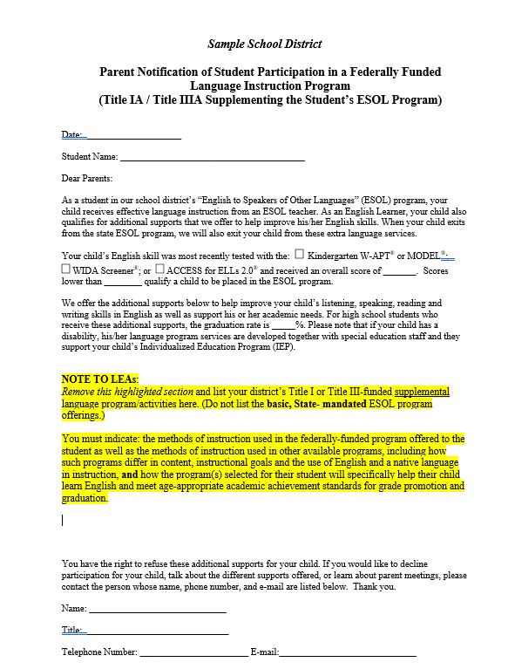
Title I Parent Notification Letter
Title I Parent Notification of Student Eligibility for Supplemental Language Support Services
The District is required to send notification, in a language and format appropriate for the reader, to parents of English Learners (Els) who have been selected to participate in the district’s Title III or Title I supplemental language program.
The supplemental language program is in addition to the state funded English to Speakers of Other Languages (ESOL) program.
Notes:
This notification must be provided to parents of participating English Language Learners (ELs) not later than 30 days after the beginning of the school year. For those children who have not been identified as ELs during the first 30 days of school, the District shall notify the children’s parents during the first 2 weeks of the EL being placed in a supplemental language program funded by Title I or Title III with the following content:
The parent notification will include:
The reasons for the identification of their child as an EL and in need of placement in a supplemental language instruction educational program;
The child’s level of English proficiency, how such level was assessed, and the status of the child’s academic achievement;
The methods of instruction used in the supplemental language program in which their child is, or will be, participating and
The methods of instruction used in other available programs, including how such programs differ in content, instructional goals, and the use of English and a native language in instruction;
how the program in which their child is, or will be, participating will meet the educational strengths and needs of their child;
how such program will specifically help their child learn English and meet age-appropriate academic achievement standards for grade promotion and graduation;
the specific exit requirements for the program, including the expected rate of transition from such program into classrooms that are not tailored for ELs, and the expected rate of graduation from high school (including four year adjusted cohort graduation rates and extended-year adjusted cohort graduation rates for such program) if funds under this part are used for children in high schools; in the case of a child with a disability, how such program meets the objectives of the individualized education program of the child, as described in section 614(d) of the Individuals with Disabilities Education Act (20 U.S.C. 1414(d)); and information pertaining to parental rights that includes written guidance—
I. detailing the right that parents have to have their child immediately removed from such program upon their request;
II. detailing the options that parents have to decline to enroll their child in such program or to choose another program or method of instruction, if available; a
III. assisting parents in selecting among various programs and methods of instruction, if more than 1 program or method is offered by the eligible entity.
When a child exits from the state ESOL program, the child will also exit from the extra language services.
Parents have the right to refuse these additional supports for their child. This notice also permits the parent to waive participation in the Title-funded services. Please note that this notification may not be applicable to all parents of ELs. It is only for parents whose EL student is receiving Title I or Title III funded services focused on English language acquisition.

Slide 28
Family Engagement Opportunities
What does the school provide for parent and family engagement?
Open House, standard &curricular night, Parent Workshops,
Literacy Night, and Career fair, etc.)
Notes:
Reminder:
Title I requires districts that receive a Title I subgrant to implement an effective means of outreach to parents of English Learners.
Outreach must include holding, and sending notice of opportunities for, regular meetings in order to gather and respond to recommendations from parents of English Learners.
Meetings must include specifics regarding ways parents can support ELs’ content knowledge and language proficiency skills

Slide 29
Family Engagement Opportunities
Ways to volunteer…
Field Trips
Proctor
Booster Clubs
Clubs/Organizations
Media Center

Slide 30
Family Engagement Opportunities
Ways to provide input and make decisions…
School Council
Title I Survey (November-December)
Title I Plans
School-Parent Compact
Parent-Teacher Conferences
Student Led Conferences
District and School Forums

Slide 31
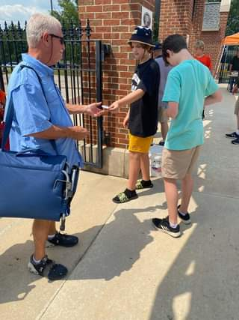
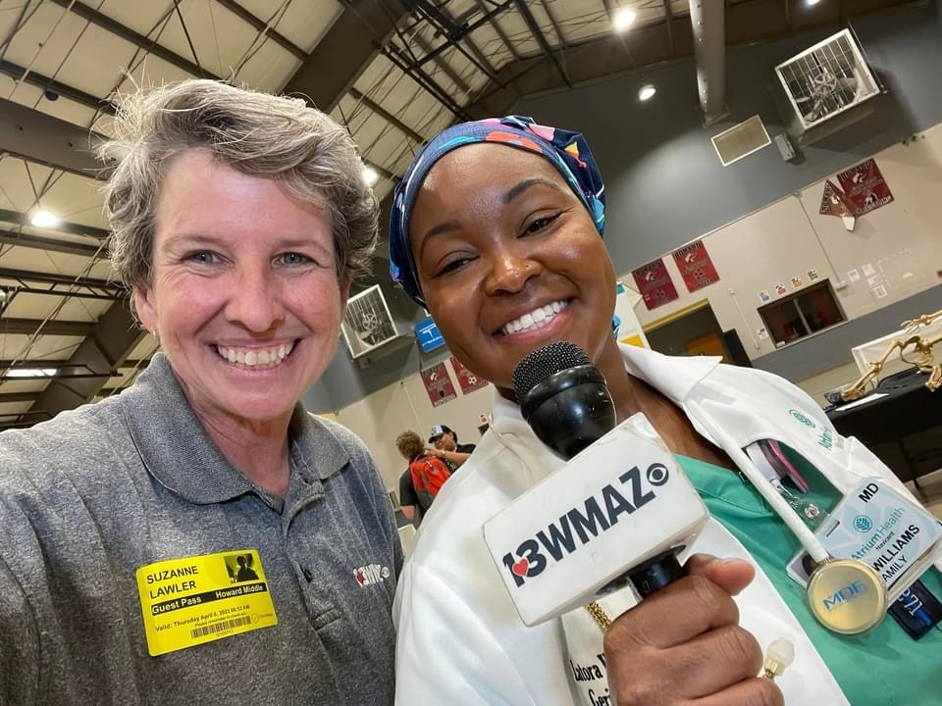
You Are Our Partners!

Slide 32
How will we be responsive to families?
Call the office any time?
478-779-3500
Mrs. Burner-478-779-3452 or
Mrs. Thurman-478-779-3448.

Slide 33
How will we be responsive to families?
Ways to Stay in touch!
Teacher emails on website
Conferences
Phone calls
Facebook
Twitter
Email
Parent Portal
Remind
Interpreters available at meetings
Documents translated as feasible
Notes:
Please place an emphasis on the importance of families sign up for Parent Portal so that they can receive Remind text messages and view student progress, specifically progress reports and report cards.

Slide 34
How will be responsive to families?
Executive Director of Supplemental Services & Migrant Liaison
Dr. Nancy Forde
(478) 765-8591
Homeless/Foster Care Liaison
Dr. Danielle Jones
(478) 765-8633
Interpreters
Amy Ovalle
(478) 779-4386
Program for Exceptional Children Parent Mentors
(478) 765-8705

Slide 35
Q&A
Notes:
Note: Please do not remove any of the information from this presentation. The contents consist of items directly aligned with the Title I Law. Please ADD items as needed, i.e. your school’s data charts, grade level requirements, parent and family engagement documents/activities etc. Thank you.

Slide 36
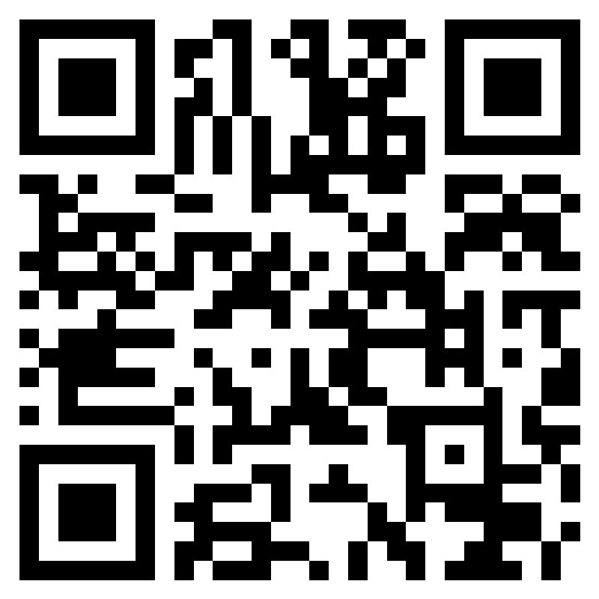
Please Complete Evaluation…
https://forms.office.com/r/dzknLdzYwc
Note: Link can be found in the Chat box
Notes:
To conclude our meeting today, be sure to scan the QR Code or click the link found in the chat box to complete the evaluation form.

